Slide 1
Agenda
Testing Microservices
Introduction to Microservices
TestingUnit Testing with Junit
Mocking with Mockito
Integration Testing with Arquillian
Performance Testing with Jmeter
Load Testing with Gatling
Best Practices in Microservices Testing

Slide 2
Introduction to Microservices

Slide 3
Importance of testing in microservices architecture
Ensures each microservice works correctly on its own.
Detects issues in communication between services.
Enables safe and fast continuous deployments.
Helps quickly identify and isolate faulty services.
Maintains overall reliability of the system.

Slide 4
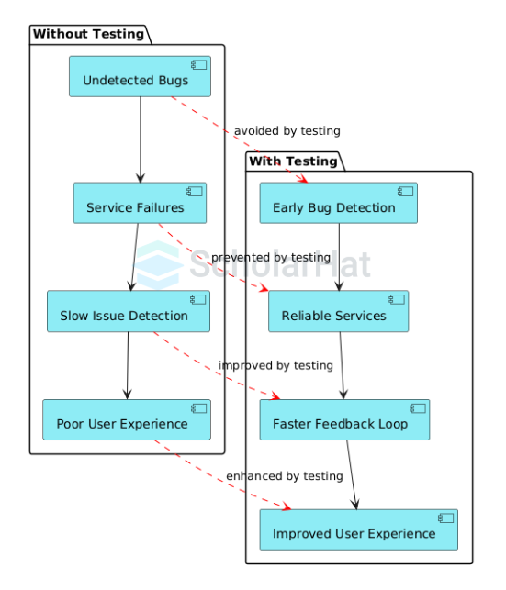
Testing Impact in Microservices

Slide 5
Types of testing
Unit Testing – Tests individual functions or components in isolation.
Integration Testing – Verifies communication between connected microservices.
Performance Testing – Checks how services perform under load or stress.
End-to-End Testing – Tests the complete workflow across all services.

Slide 6
Types of testing
Contract Testing – Ensures APIs between services follow agreed formats.
Security Testing – Identifies vulnerabilities and enforces data protection.
Smoke Testing – Validates basic functionality after deployments.
Regression Testing – Ensures new changes don’t break existing features.

Slide 7
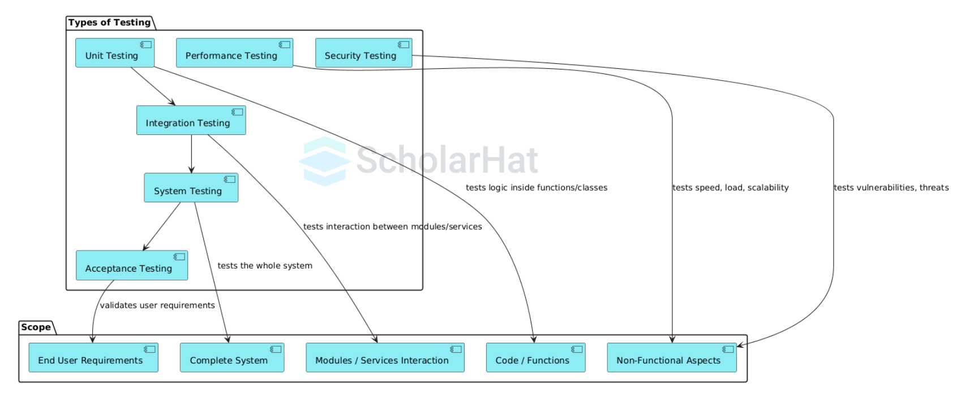
Types of Testing

Slide 8
Unit Testing with JUnit

Slide 9
Basics of JUnit for testing Java code
JUnit is a framework for unit testing Java code.
@Test marks methods to be tested.
Assertions like assertEquals() check expected results.
Lifecycle Annotations handle test setup and cleanup.
JUnit 5 (Jupiter) is the latest version with enhanced features.

Slide 10
Example of unit tests for service methods
import org.junit.jupiter.api.Test;
import static org.junit.jupiter.api.Assertions.*;
class MathService {
int add(int a, int b) {
return a + b;
}
}
public class MathServiceTest {
@Test
void testAdd() {
MathService service = new MathService();
assertEquals(7, service.add(3, 4));
}
}

Slide 11
Mocking Dependencies with Mockito

Slide 12
Mocking Dependencies with Mockito
Mockito is a framework to create mock objects in unit tests.
It helps test classes without needing real dependencies.
Use @Mock to create a mock object.
Use when(...).thenReturn(...) to define mock behavior.
Use verify() to check if methods were called.

Slide 13
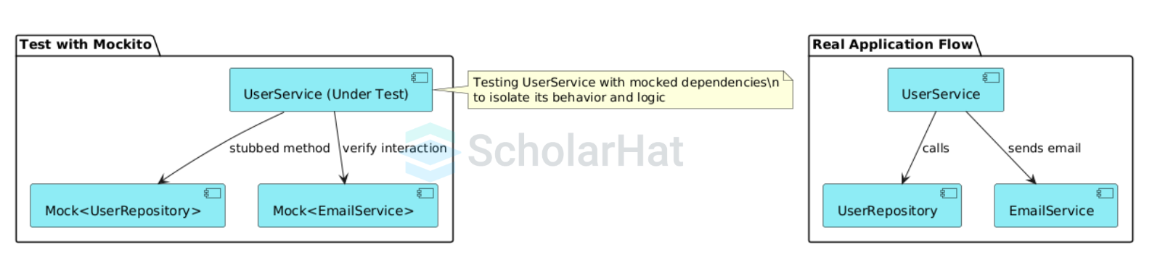
Real vs Mocked Dependencies in Service Testing

Slide 14
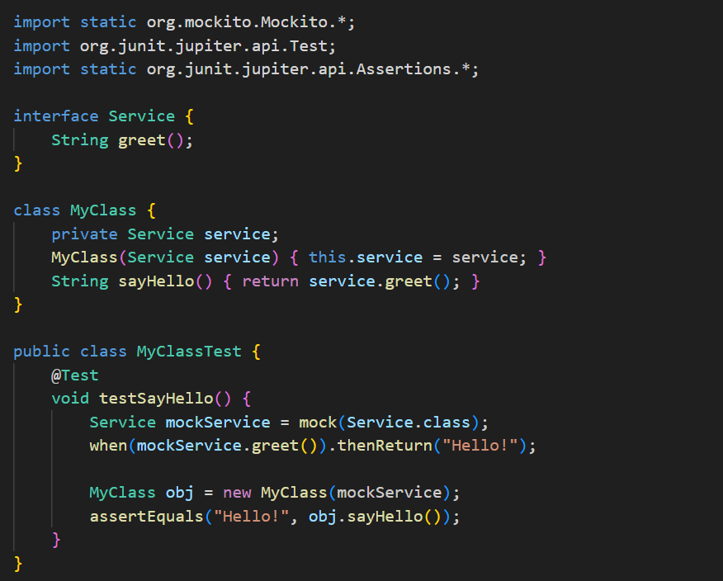
Example of unit tests for service methods

Slide 15
Writing behavior-driven unit tests
Focuses on testing expected behavior, not just code.
Uses clear, descriptive test method names.
Makes tests easier to understand for all team members.
Bridges gap between developers and business stakeholders.
Often used with frameworks like JUnit or Cucumber.

Slide 16
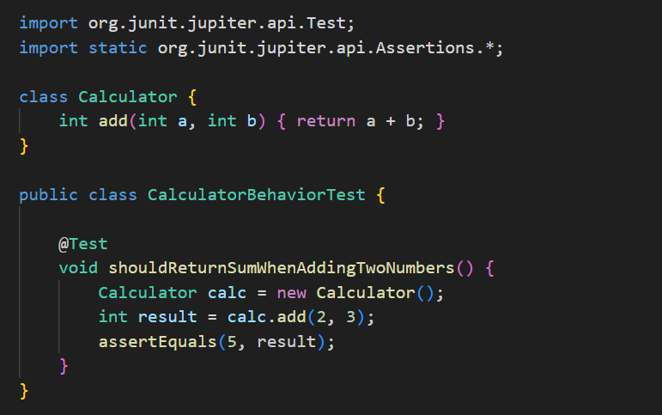
Small JUnit Example (Behavior-Driven Style)

Slide 17
Integration Testing with Arquillian

Slide 18
Integration Testing with Arquillian
Runs tests inside real Java EE containers.
Tests microservices in a realistic environment.
Supports remote and embedded containers.
Simplifies integration of multiple components.
Automates deployment during testing

Slide 19
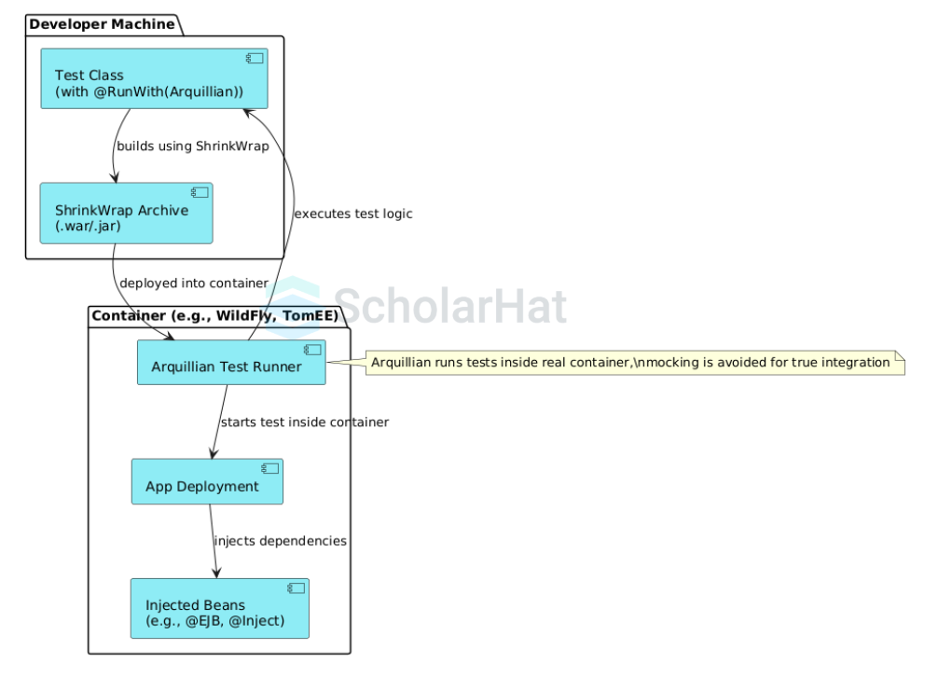
In-Container Testing Flow with Arquillian Deployment

Slide 20
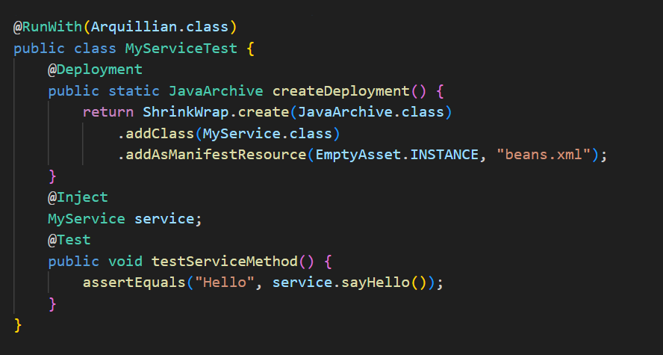
Example: Integration Test with Arquillian

Slide 21
Testing Microservices in a Real Container
Validates actual runtime behavior.
Ensures proper configuration and deployment.
Tests interactions with real dependencies.
Detects environment-specific issues early.
Improves confidence before production.

Slide 22
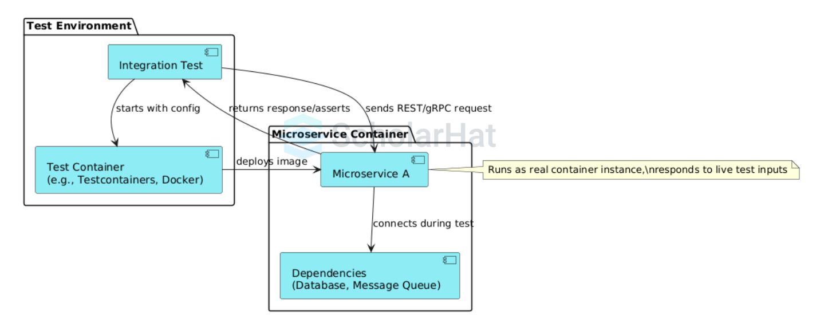
Microservice Testing in Real Container Environment

Slide 23
Benefits of Arquillian for Java EE Microservices
Easy setup for in-container testing.
Supports multiple container types.
Reduces need for complex mocks.
Integrates with popular test frameworks (JUnit, TestNG).
Speeds up development with accurate tests

Slide 24
Performance Testing with JMeter

Slide 25
Performance Testing with Apache JMeter
Open-source tool for load and performance testing.
Simulates multiple users to test system limits.
Supports HTTP, JMS, JDBC, and more protocols.
Provides detailed reports and graphs.
Helps identify bottlenecks in microservices.

Slide 26
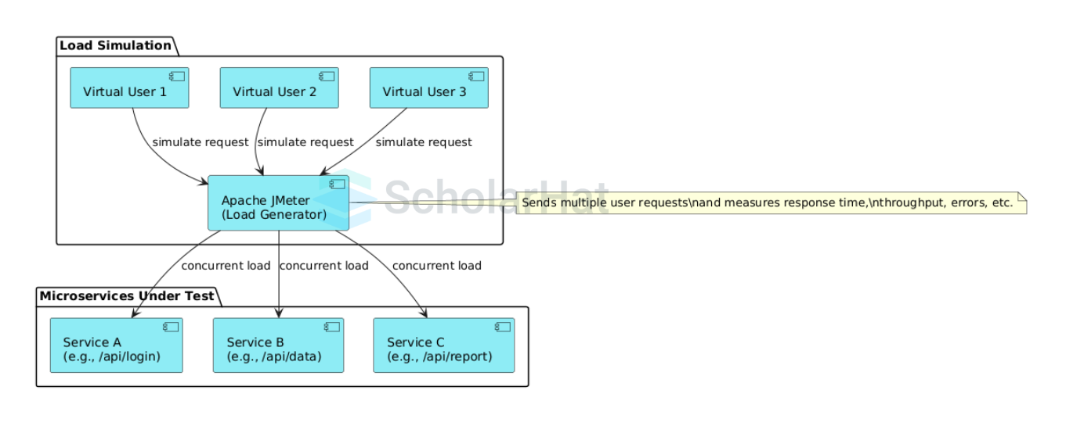
JMeter Load Testing

Slide 27
Introduction to JMeter for Load Testing
Create test plans with threads (virtual users).
Define requests to simulate real user actions.
Configure timers and assertions for realism.
Run tests locally or distributed.
Analyze performance metrics post-test

Slide 28
Simulating Real-World Traffic on Microservices
Use concurrent threads to mimic users.
Vary request types and payloads.
Include pauses and think times.
Test under peak load conditions.
Measure response time and throughput

Slide 29
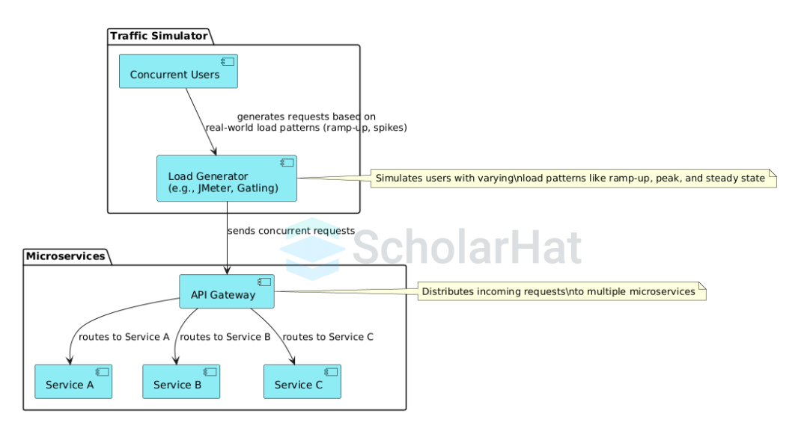
Microservice Traffic Simulation

Slide 30
Advanced Load Testing with Gatling

Slide 31
Advanced Load Testing with Gatling
Scala-based DSL for flexible test scripts.
High-performance, asynchronous load testing.
Real-time monitoring and detailed reports.
Easy integration with CI pipelines.
Supports HTTP, WebSocket, JMS protocols

Slide 32
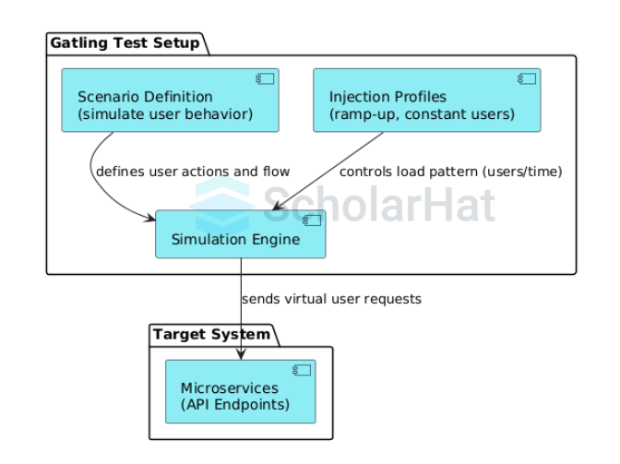
Gatling Test Flow

Slide 33
Features of Gatling
Powerful Scala DSL for complex scenarios.
Efficient resource usage for large loads.
Extensible with custom code.
Built-in HTML reports for analysis.
Supports scenario parameterization

Slide 34
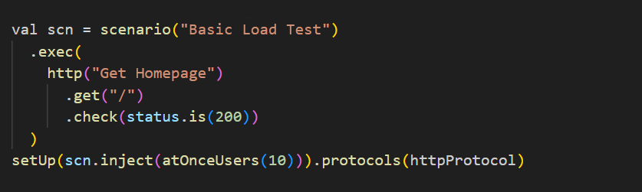
Example: Gatling Scenario (Scala DSL)

Slide 35
Creating Realistic Test Scenarios
Model user behavior accurately.
Include varied data inputs.
Simulate network delays and failures.
Mix different types of requests.
Validate functional and performance aspects

Slide 36
Best Practices in Microservices Testing

Slide 37
Best Practices in Microservices Testing
Integrate testing into CI/CD pipelines
Use isolated environments per test run
Manage and reset test data reliably
Automate unit, integration, and performance tests
Monitor test coverage and flaky tests

Slide 38
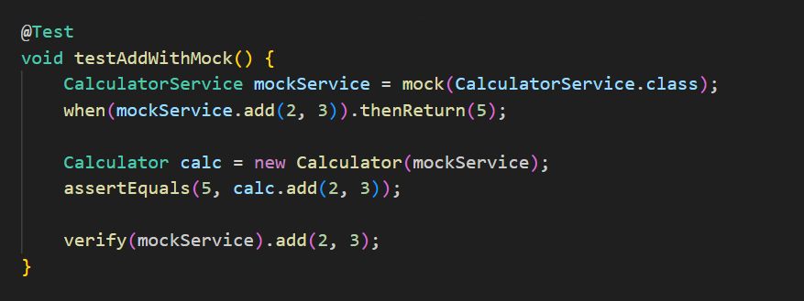
Example: Mockito Mocking

